Slide 1

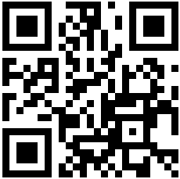
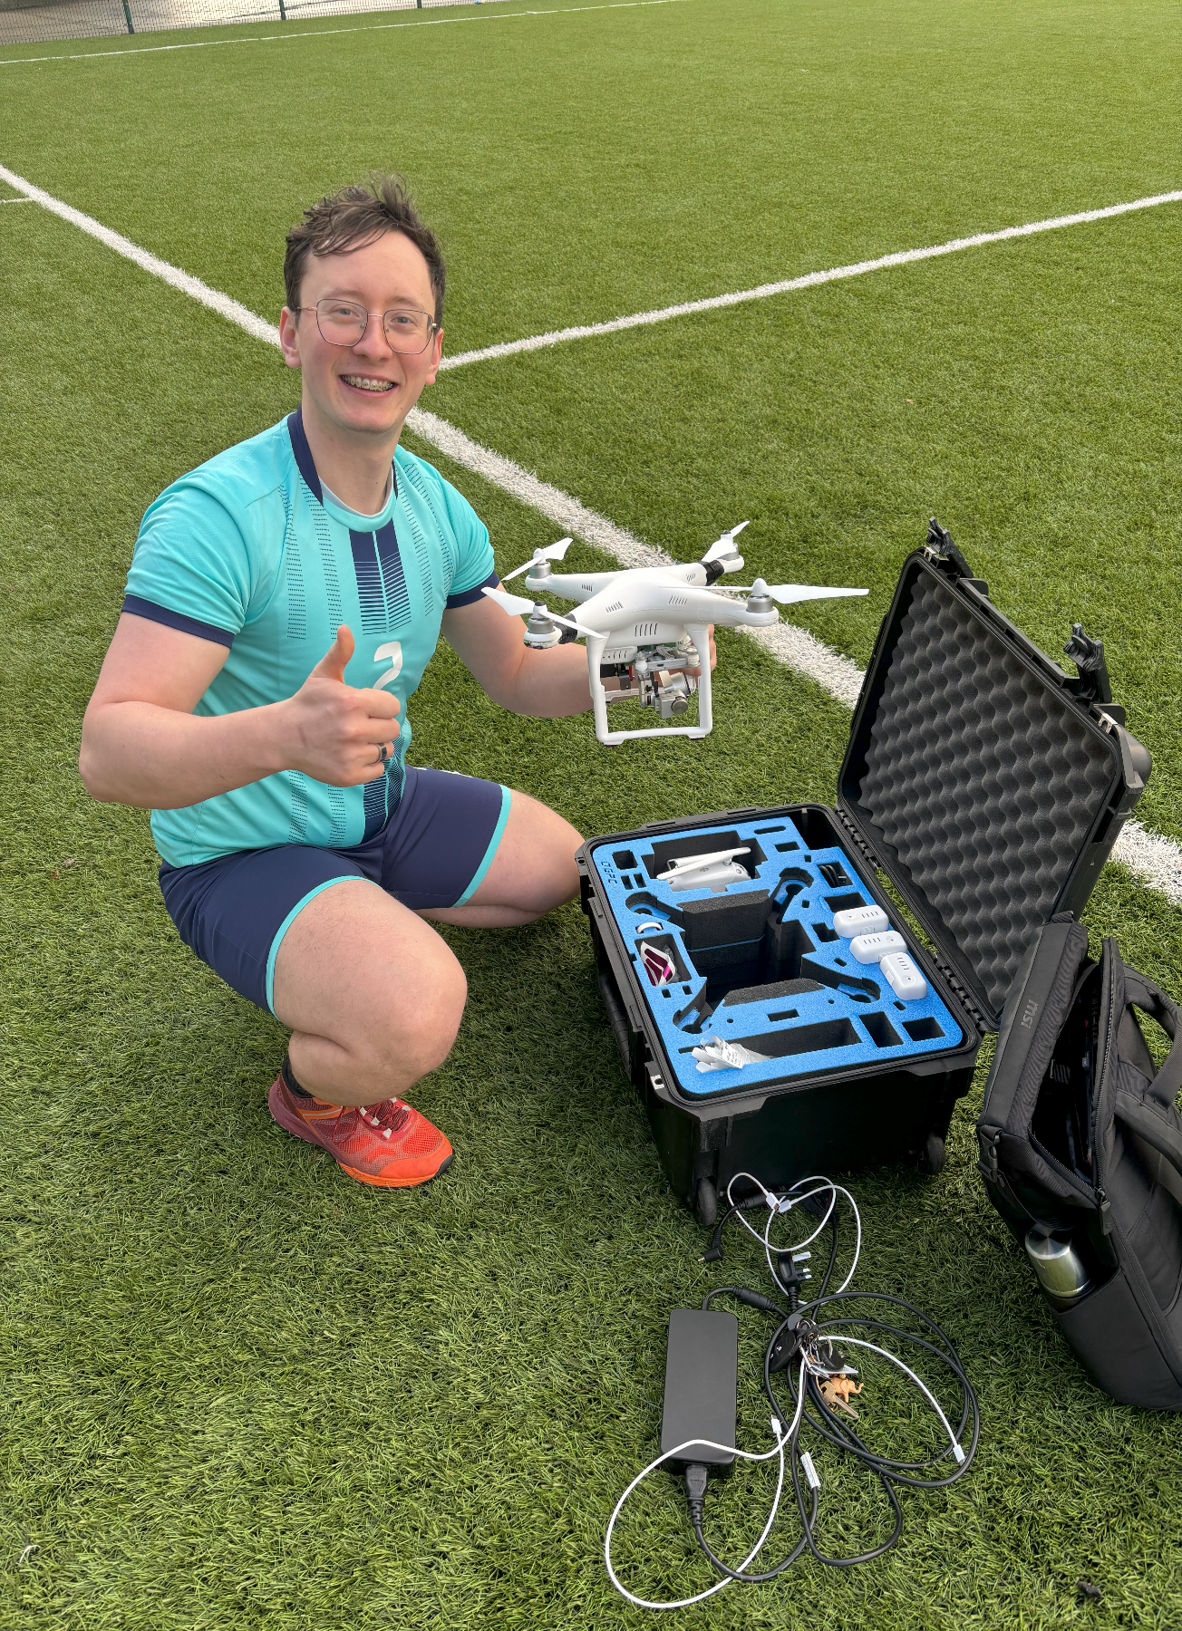
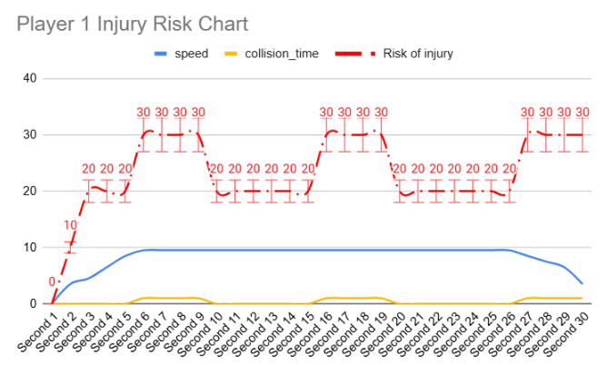
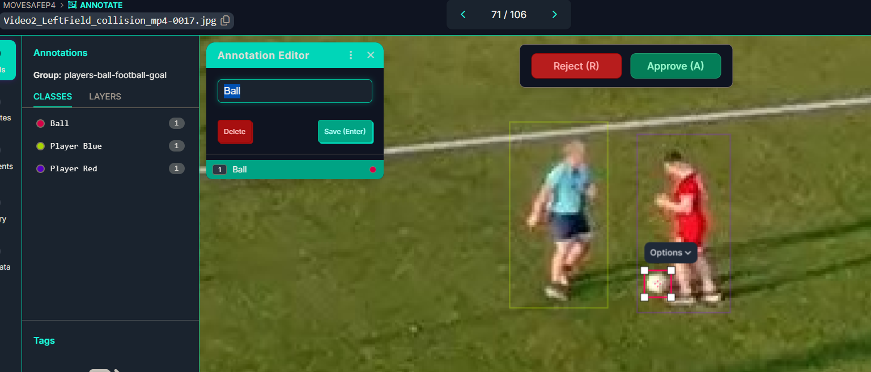
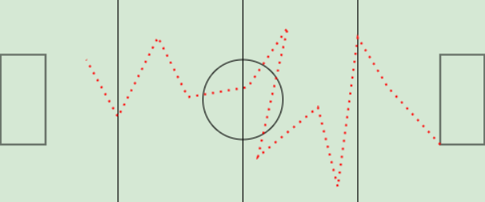
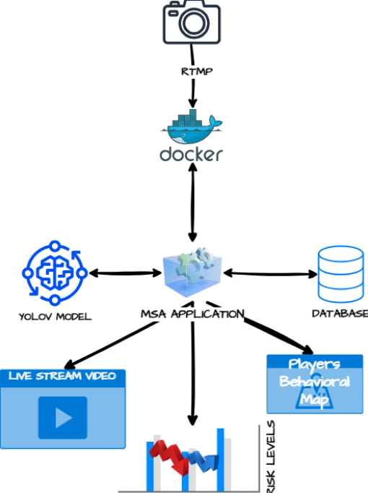

Move Safe Analytics: Injury in field sports preventing system powered by drone.
Scan for Video
Ivan Lapickij¹, Guilherme Daniel Gomes²
¹ 4th Year Student, BEng in Poster Design
² Supervisor, Department of Computer and Software Engineering, Technological University of The Shannon: Midlands Midwest
Abstract: Field sports are a billion-dollar industry where performance tracking and statistics drive winning strategies. However, few technologies protect players—the most valuable assets—from injury. Move Safe Analytics (MSA) leverages AI-powered drones to monitor players in real time, analyze risk levels, and provide live feedback during matches and training. Metrics such as collision frequency, high-intensity sprint count, and on-field behavioral patterns are used to identify injury risks, enabling teams to minimize hazards or manage acceptable risks based on expert analysis.
Results and Discussion: Gathered statistics shows factors and timestamps where risk of injuries levels rise. Behavioural map could be used in combination to see does players position actually commit to injury risks and how player was behaving on field during game etc. did he abandoned his position as defender.
Introduction: Currently, technology is advancing and making our lives better in many aspects. Sports were always fascinating entertainment that brought people together. The most breathtaking moment is when players sacrifice for the team's goal. To have more of those moments for fans and players, for the game to continue its very important that no injury would arise. Here technology must keep being researched to be utilized to prevent injury and traumas so that games would be safer for players.
MSA - application that ensures the output of real-time data that points to danger zones for future game analysis toward injury prevention.
Methodology:
In MSA development was used Python language since its most popular and easiest to work with machine learning, object detection & tracking.
Conclusion: Data gathered using MSA could be used to minimize or avoid injuries by reshaping strategy and improving safety of game.
Future Work: Application have a lot of potential where further implementations could involve movement tracking - to be precise “skeleton” Yolov model that tracks movement of body , particularly knee bending angle while running to direct correct movement or discover hidden trauma. PATTERNS
Acknowledgments
Fbmlfmb;lfdmb;lmblm’blmfgmbLmb’lm;Lamf@Lmb’Amb’lmb’lam’bLma;lmfb;lm

